Slide 1
Automatic Coil Winder
Max Jost, Martin Steiner, Aleksey Sokolov

Slide 2
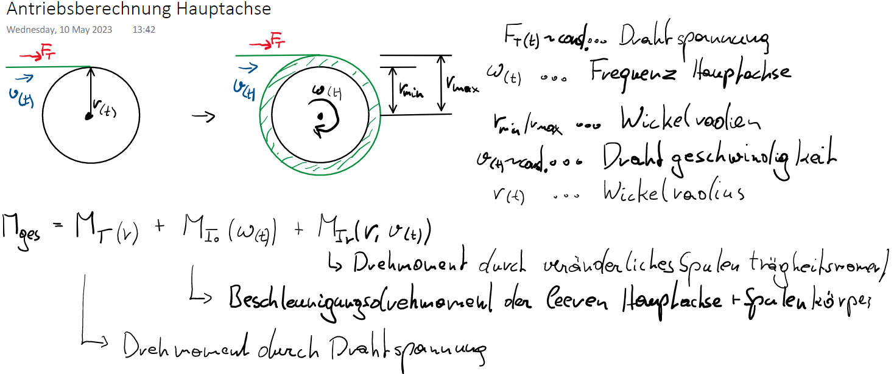



Slide 3
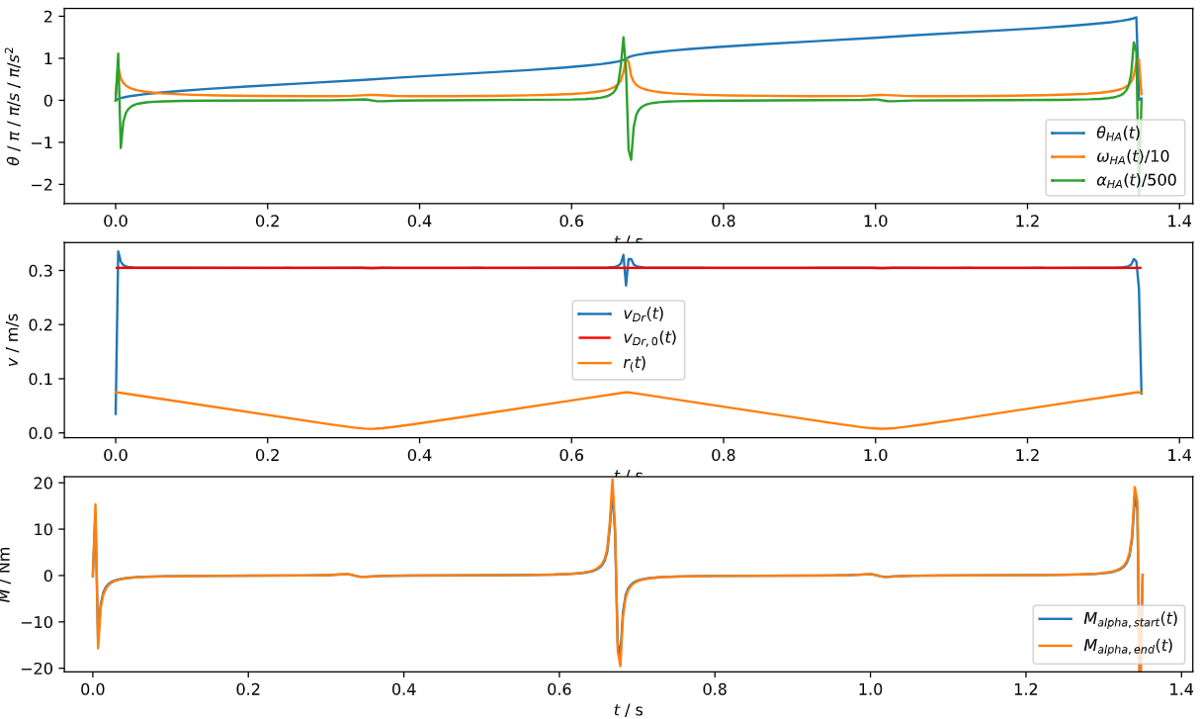
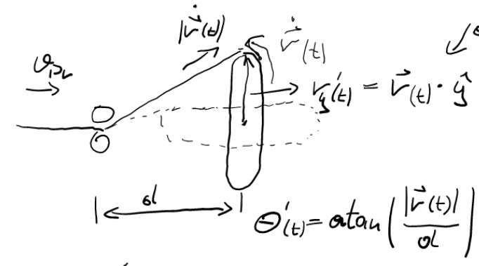





Slide 4
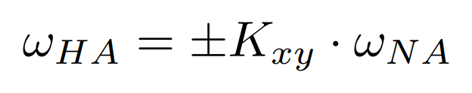
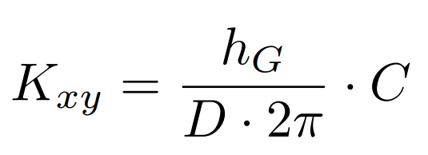

Slide 5
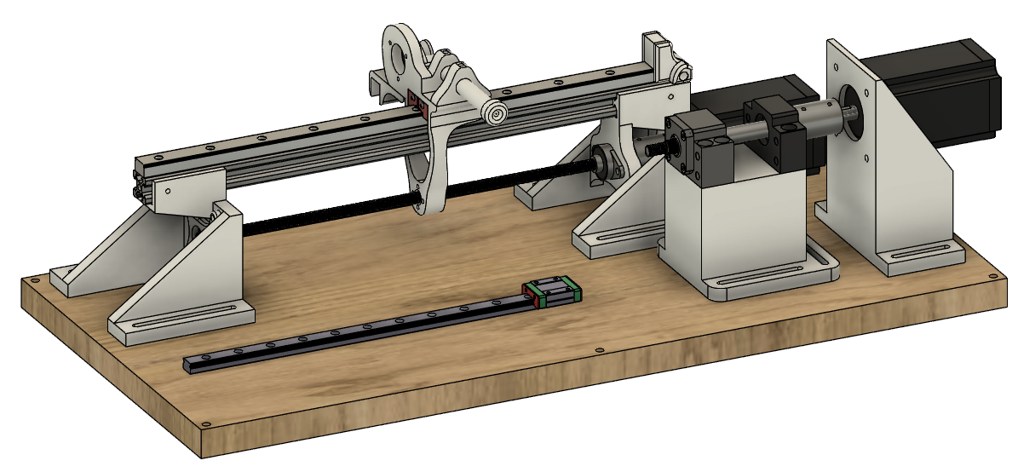

Slide 6
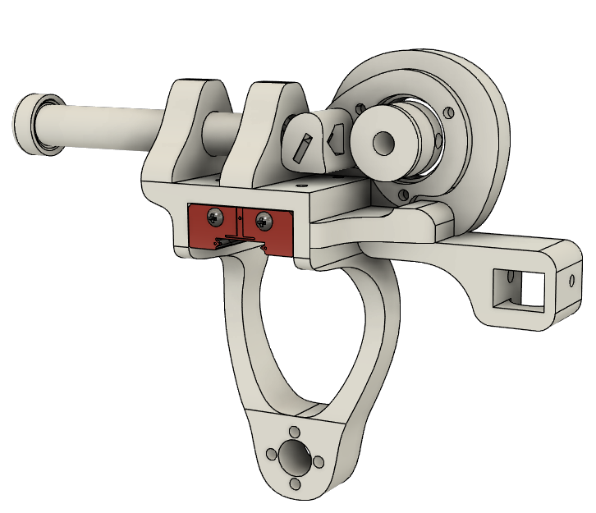

Slide 7
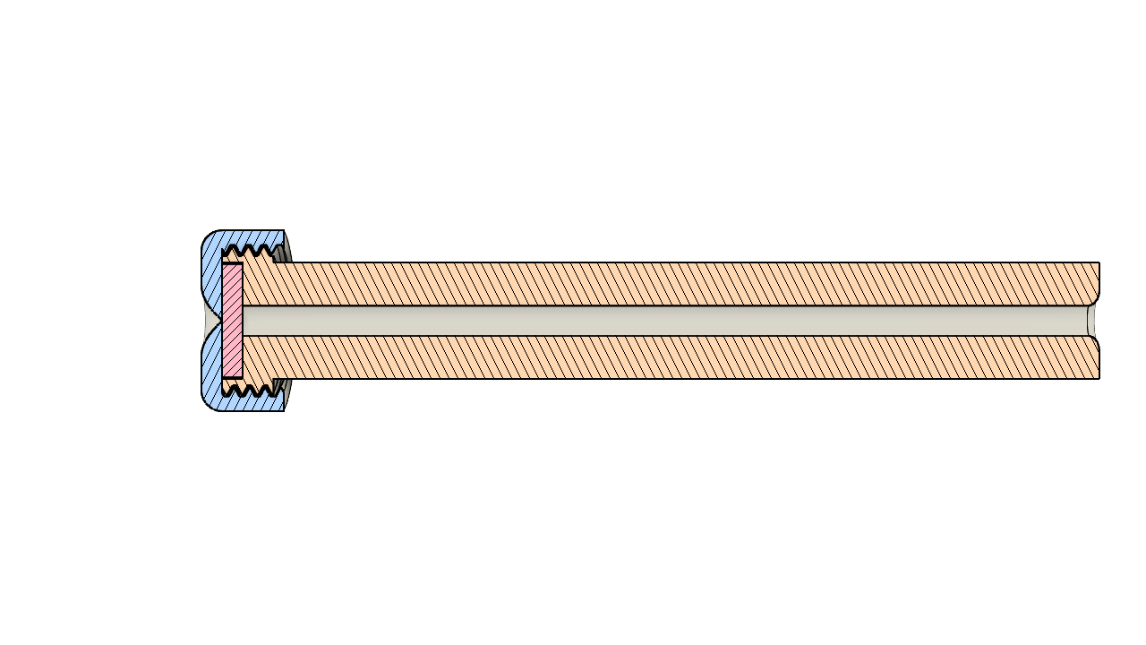

Slide 8
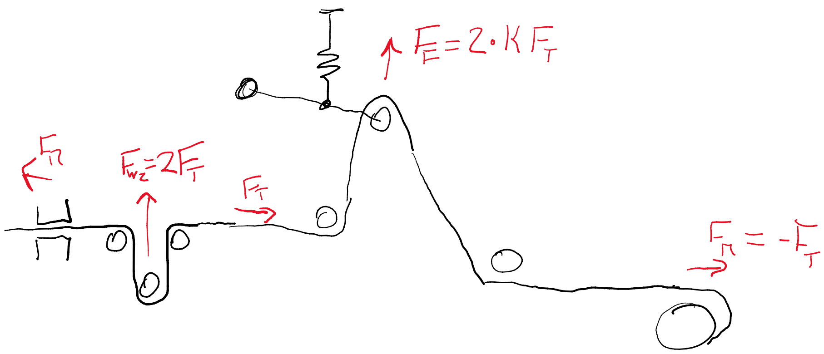

Slide 9
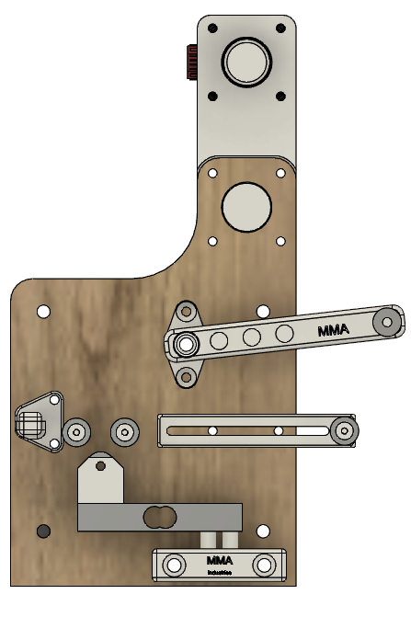

Slide 10
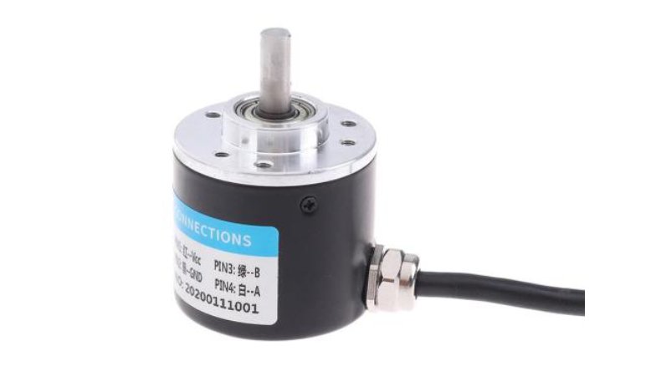
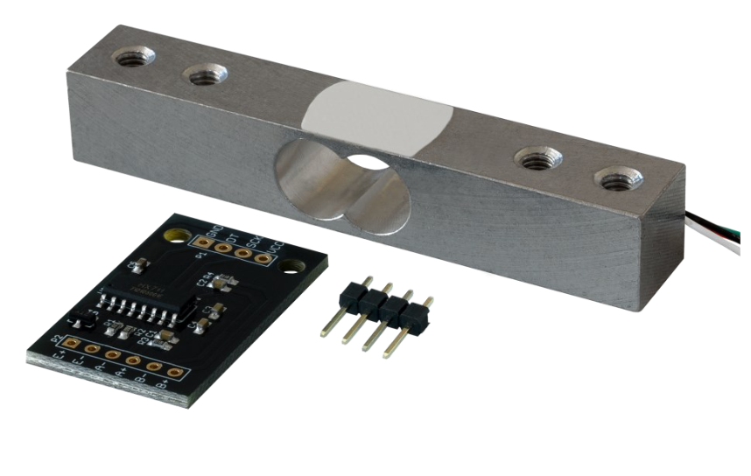
1kg Wägezelle mit HX711 24 bit ADC
Messrate max. 80Hz
Opt. Impulsgeber, über A/B Phase mit 600 Imp/U je Phase ->
Auflösung 2400 Imp/U

Slide 11
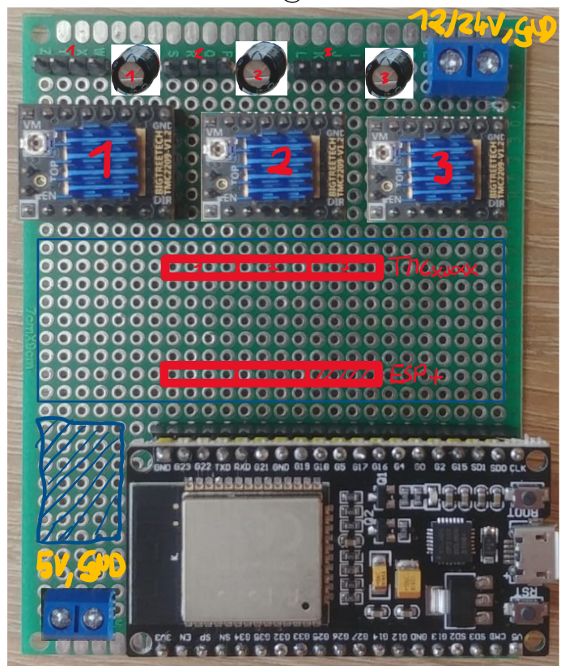
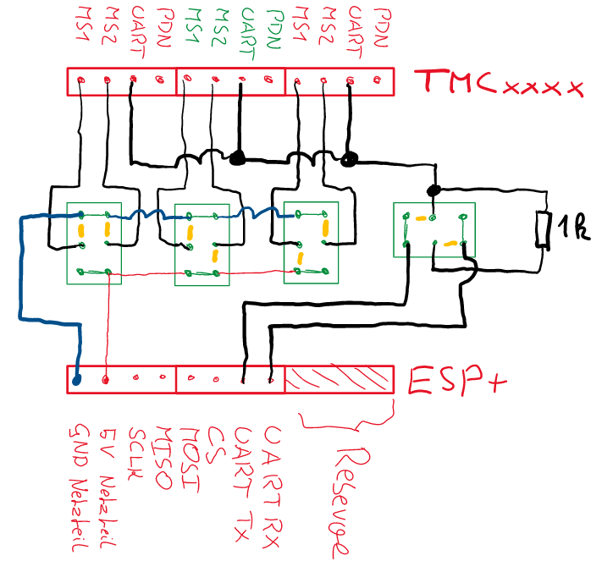
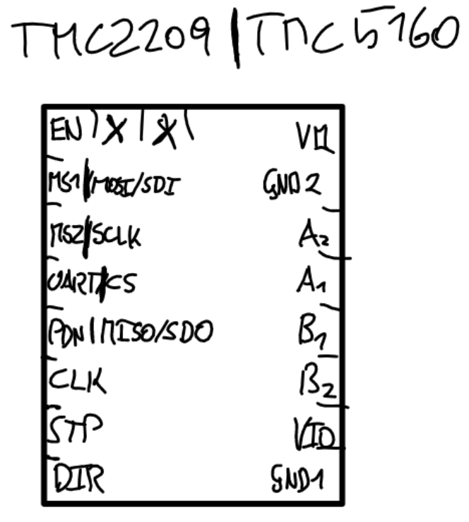

Slide 12
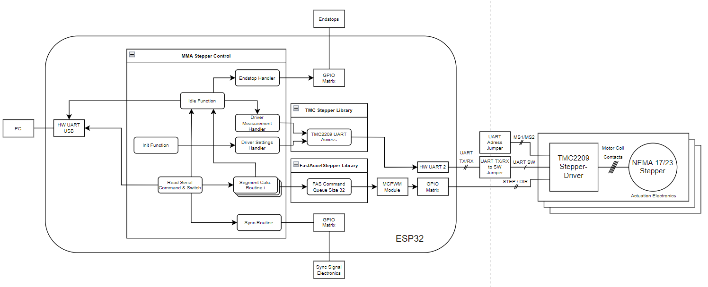

Slide 13
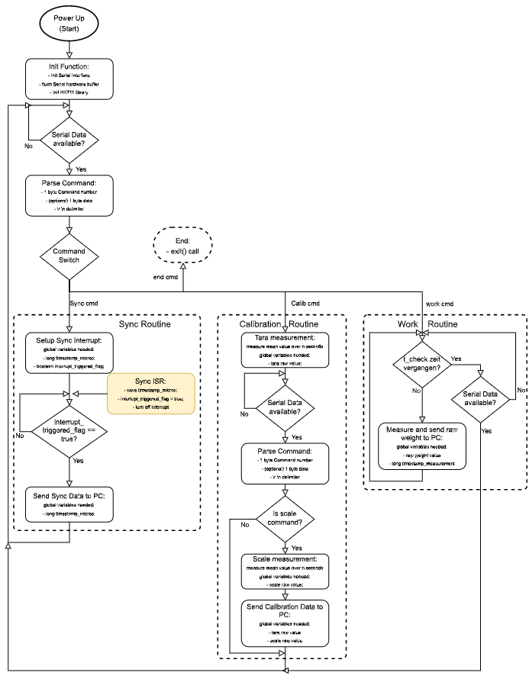

Slide 14
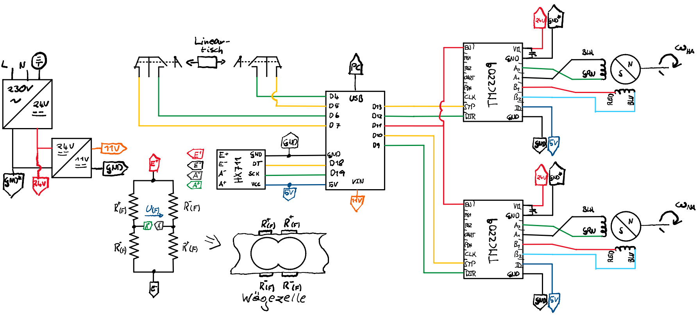

Slide 15
Zweite Achse für Enceladus
if((MotorDirection==0 && second_axis_dir_rev==0) ||
(MotorDirection==1 && second_axis_dir_rev==1)) {
//forward
digitalWrite(MOTOR_DIRECTION2, HIGH);
if(K_xy_count == K_xy){
// Perform one Motorstep
digitalWrite(MOTOR_STEP2, HIGH);
digitalWrite(MOTOR_STEP2, LOW);
K_xy_count = 0;
CurrentPosition2 ++;
} else {
K_xy_count++;
}
}
else { //backward
digitalWrite(MOTOR_DIRECTION2, LOW);
if(K_xy_count == -1){
// Perform one Motorstep
digitalWrite(MOTOR_STEP2,HIGH);
digitalWrite(MOTOR_STEP2, LOW);
K_xy_count = K_xy - 1;
CurrentPosition2 --;
} else {
K_xy_count--;
}
}

Slide 16
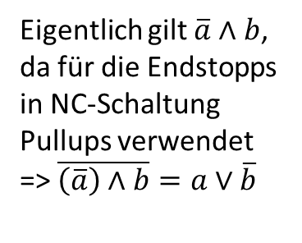
Endstopperkennung
int endstop = 0; // value is 0 if no endstop is reached
const int mask = 0b10100000;
int previous_endstopt_val = 0;
void EndstopRead() // NC_l pin5, NC_r pin7
{
byte b = (~PIND) & mask;
endstop = previous_endstopt_val & ~b;
previous_endstopt_val = b;
}
Eigentlich gilt $\overline{a}∧b$, da für die Endstopps in NC-Schaltung Pullups verwendet
=> $\overline{\left(\overline{a}\right)∧b}=a∨\overline{b}$

Slide 17
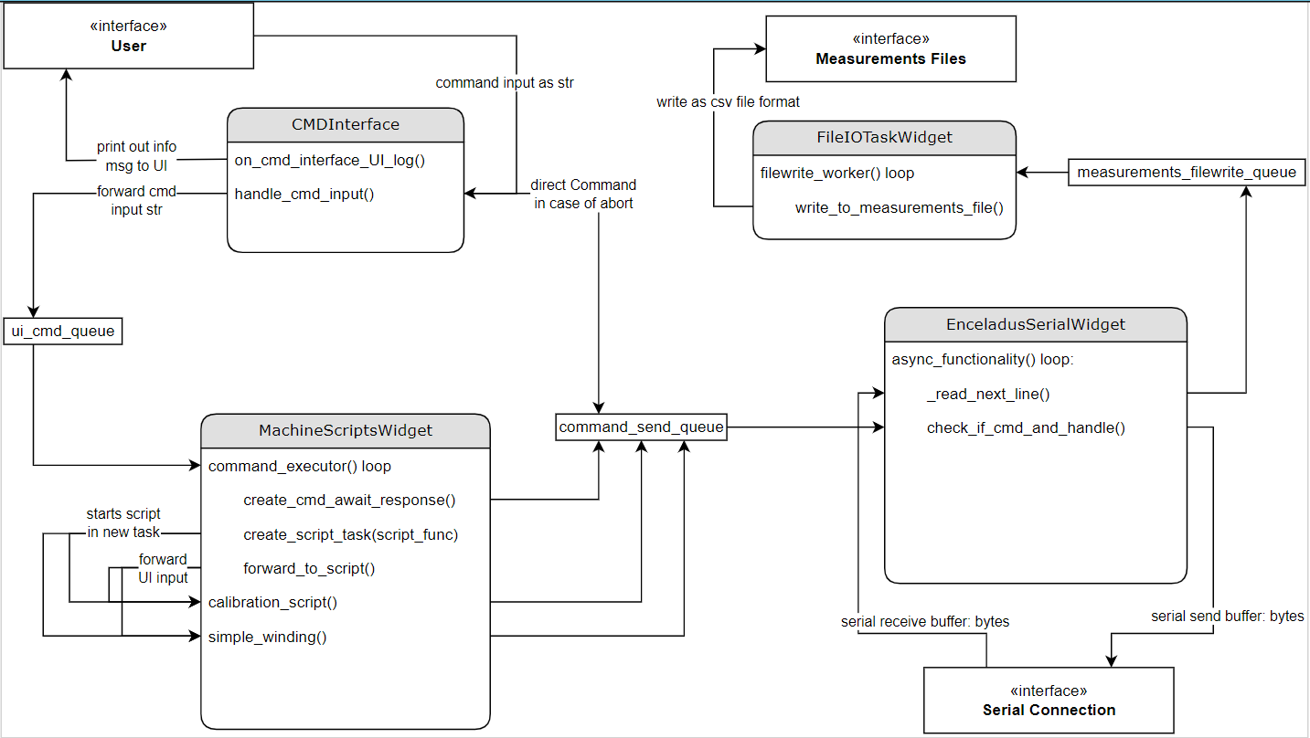

Slide 18
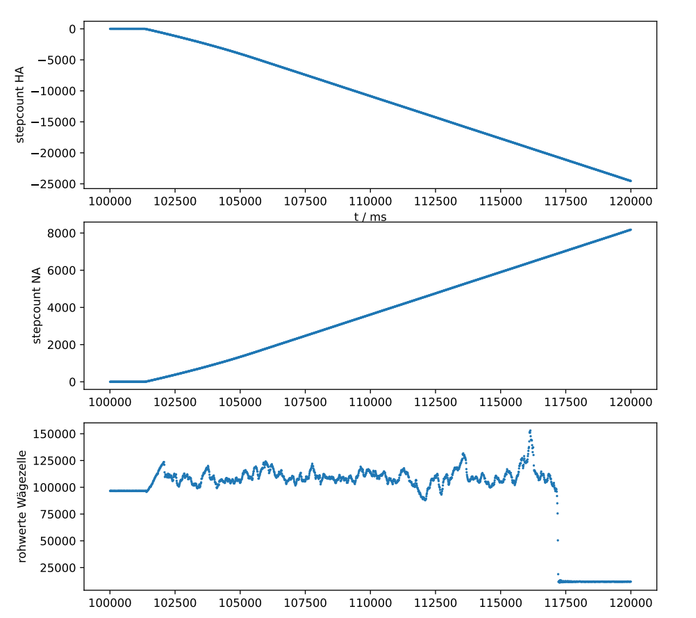

Slide 19
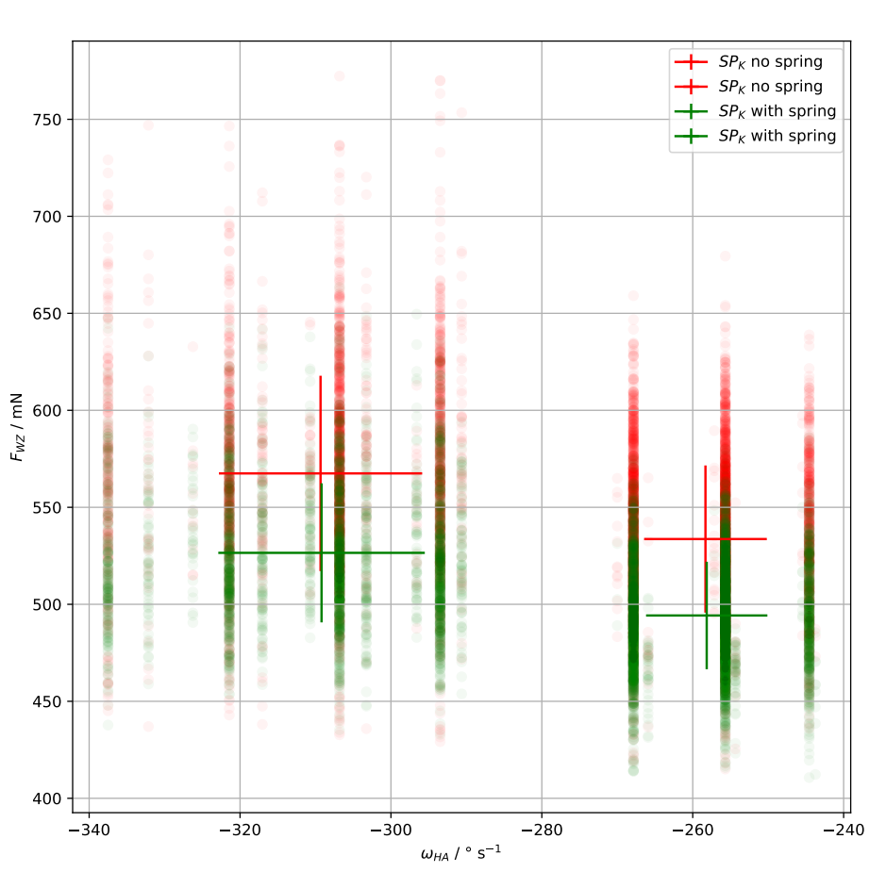

Slide 20
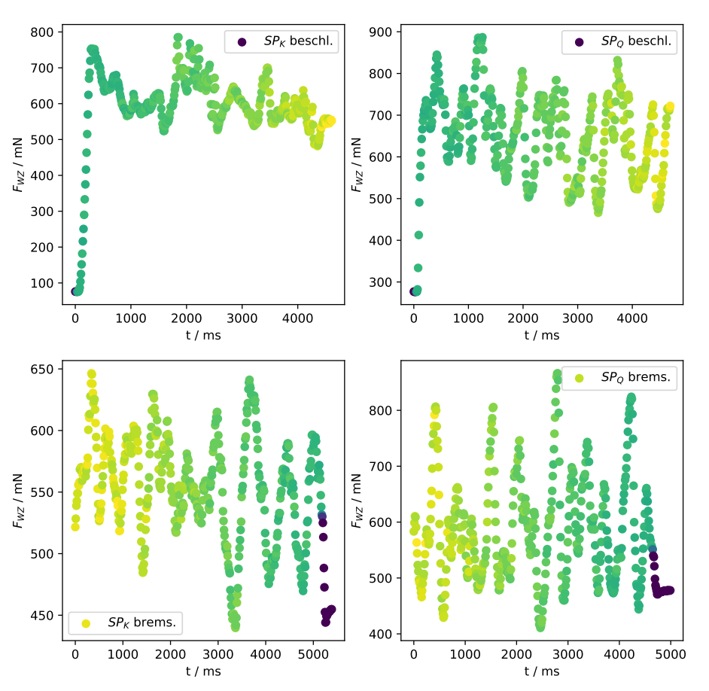

Slide 21
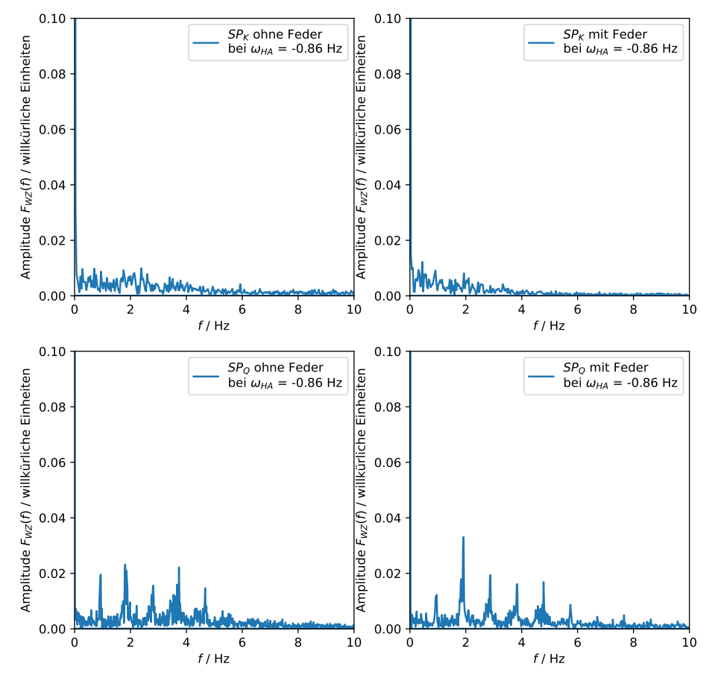

Slide 22
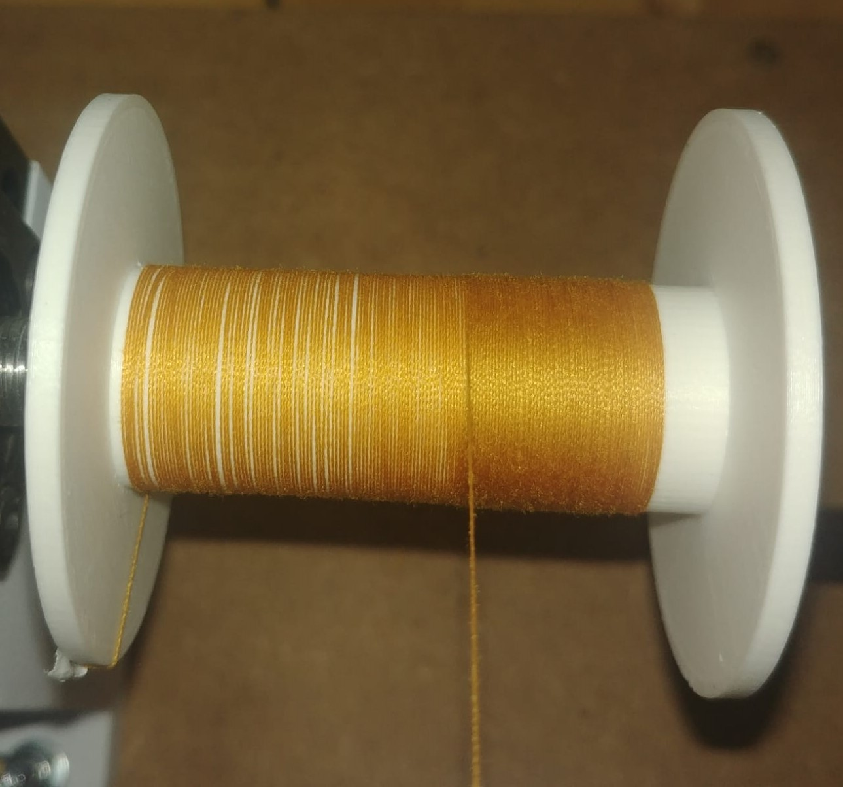

Slide 23
